Slide 1
Radar System Using Auduino UNO And Ultrasonic Sensor
Presented by:
Shyam Sarvaiya (19EL090)

Slide 2
Contentsable of Contents
Introduction to Radar System
Components and their description
Block Diagram
Circuit Diagram
Working Principle
Problem Statement
Key points and improvements
Applications
Conclusion

Slide 3
Introduction to Radar System
Radar is a long-range object detection system that uses radio waves to establish certain parameters of an object like its range, speed and position
The project is based on Sonar technology as I will be using an Ultrasonic Sensor to determine the presence of any object in a particular range.
Rader is an object detection system. It uses Microwaves to determine the range, altitude, direction, or speed of objects. The radar can transmit radio waves or microwaves which bounce off any object in their path. So, we can easily determine any object in the radar range.

Slide 4
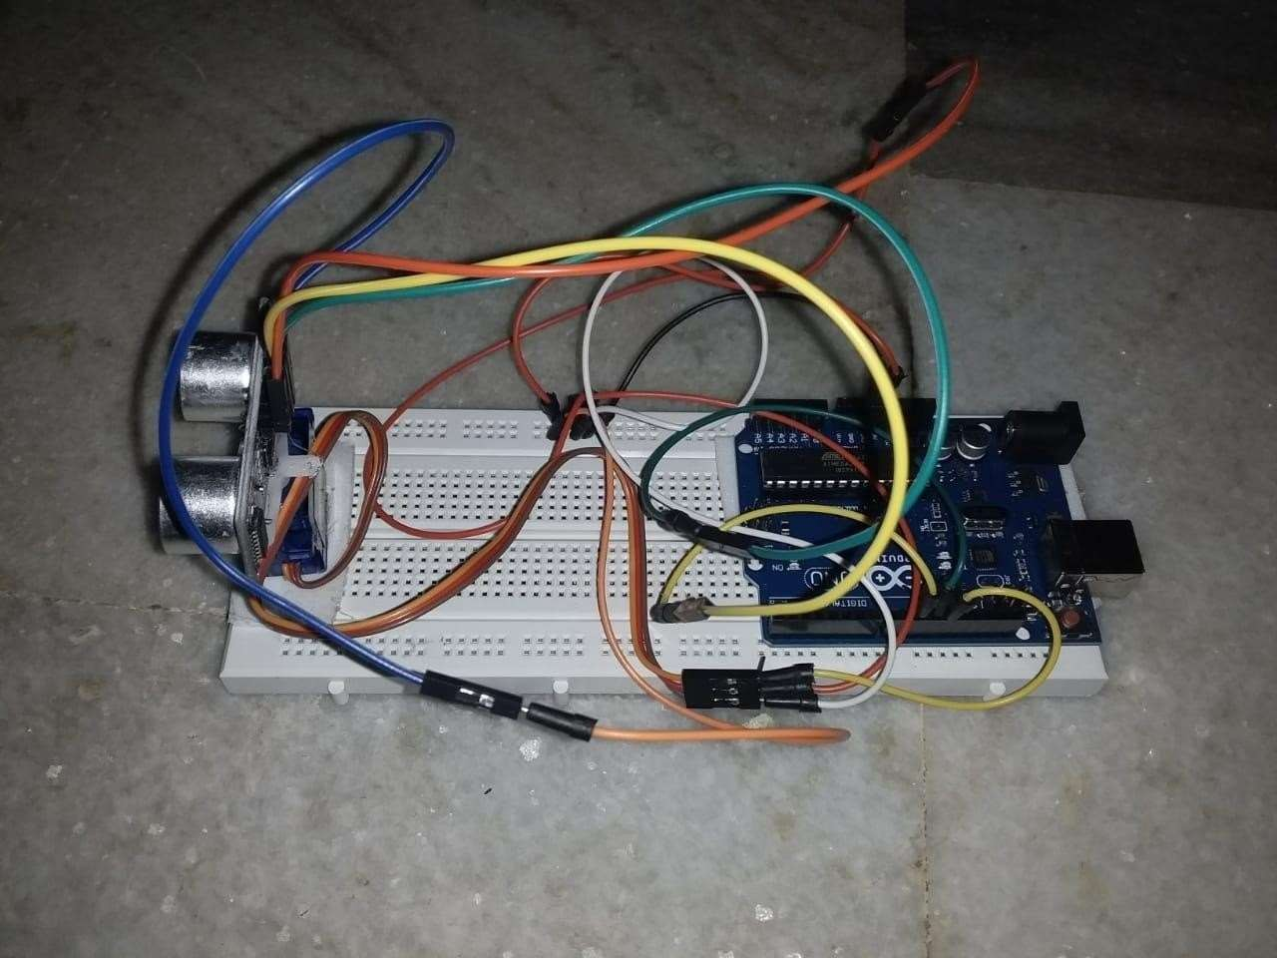
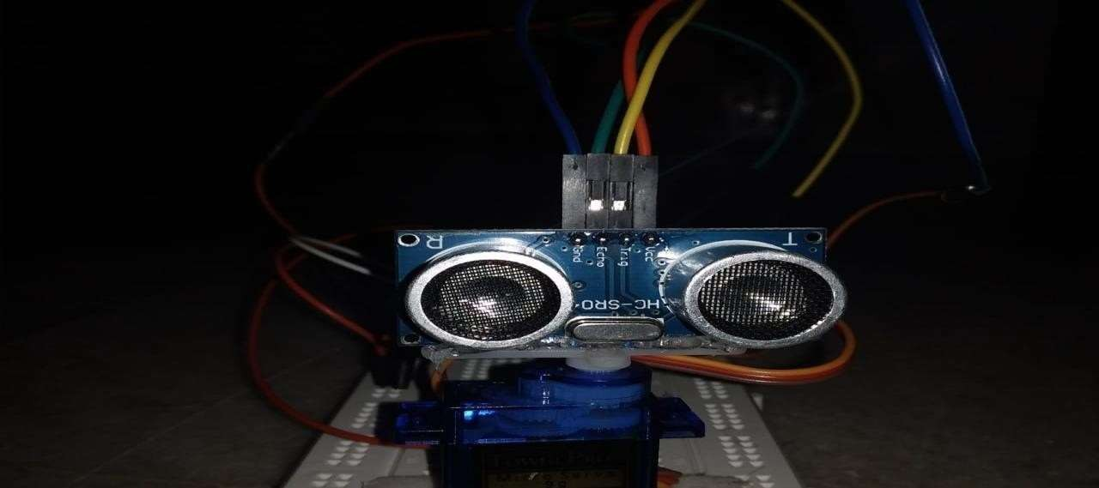
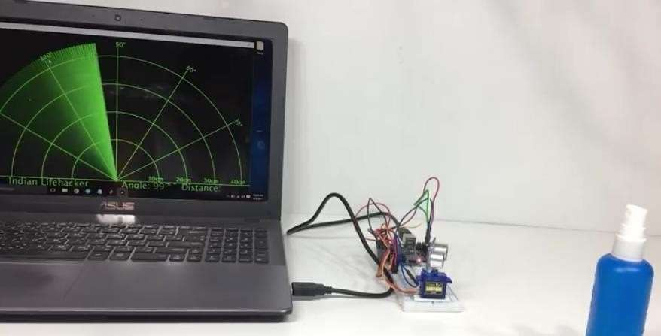

Slide 5
Components:
Hardware
Arduino UNO
HC-SR04 Ultrasonic Sensor
Tower Pro SG90 Servo Motor
Jumper Cables + USB Cable (for Arduino)
Software
Arduino IDE
Processing Application

Slide 6
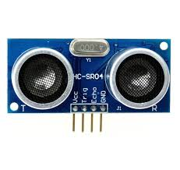
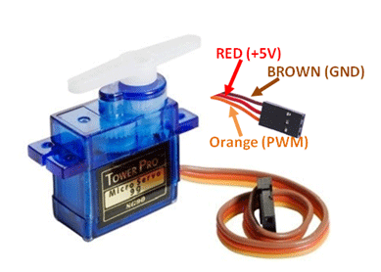
Ultrasonic Sensor:
Ultrasonic sensor is mainly used to determine the distance of the target object.
Transmitter and receiver are two main parts of the sensor where former converts an electrical signal to ultrasonic waves while later converts that ultrasonic signals back to electrical signals.
Its operating frequency is 4 MHz and its detection range is from 2cm to 400 cm.
Servo Motor:
Servo motor is a motor which requires +5V to operate and having a torque of 2.5kg/cm. It must be kept in mind that it can only rotate from 0°-180°.

Slide 7
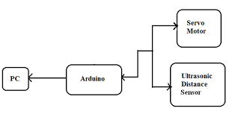
Block Diagram

Slide 8
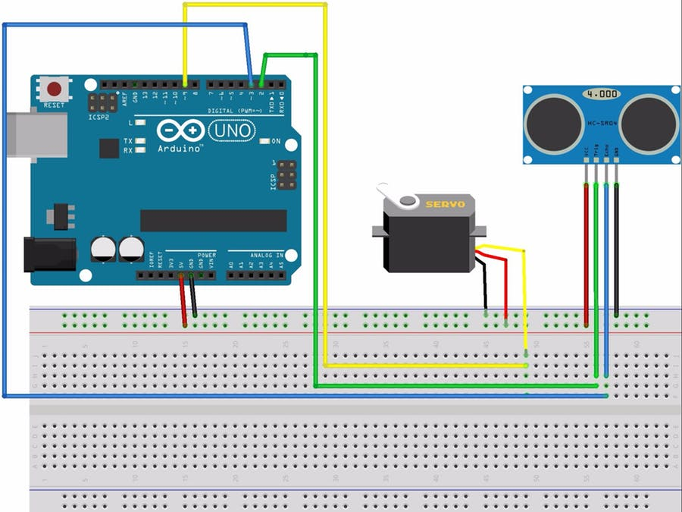
Circuit Diagram

Slide 9
Working Principle
The basic objective of our design is to ascertain the distance position and speed of the obstacle set at some distance from the sensor. Ultrasonic sensor sends the ultrasonic wave in various ways by rotating with help of servo motors. This wave goes in air and gets reflected back subsequent to striking some object. This wave is again detected by the sensor and its qualities is analyzed and output is shown in screen indicating parameters, for example, distance and position of object. Arduino IDE is utilized to compose code and transfer coding in Arduino and causes us to detect position or angle of servo motor and it is communicated through the serial port alongside the covered distance of the nearest object in its way.
Output of all of this working is shown in the software called processing, it will display the input/output and the range of the object.

Slide 10
Implementations of the sensors are done in such a way that ultra-sonic sensor is attached on top of the servo motor because it have to detect the object and its distance. Arduino (micro-controller) will control the ultra-sonic sensor and servo motor and also powered will be given to both of them through micro-controller.
When any obstacle/object is detected by the ultrasonic sensor the data is immediately processed by the controller and is fed to the IDE which shows it on the display screen. Here the process ends with an estimated distance of the object from the system with the angle at which it is placed.

Slide 11
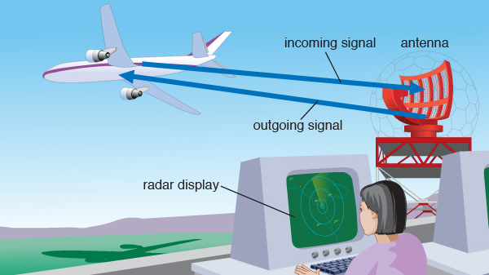

Slide 12
Problem Statement
When the airplanes were invented so there is need of an instrument that could detect their location and time. So there is need of a system that could detect the aircrafts in air.
So to overcome this problem the scientists invented the “Radar System”, and our whole defence system, air-traffic, airport system is based on it.

Slide 13
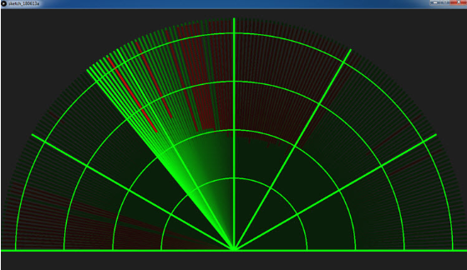
Key points and Improvements
Instead of providing a different voltage source for operating ultrasonic sensor and servo motor, we have used supply from the micro-controller. By this way we reduced the cost of voltage supplies.
Earlier the output screen was like this:

Slide 14
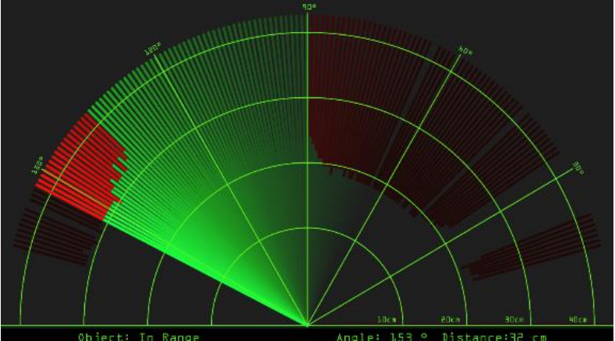
After making some changes in the coding the output screen looks like this:
Now, it will show us the accurate distance as well as angle of the object which is much more accurate as compared to the previous output. This output screen is based on the polar coordinates system.

Slide 15
Applications
Radar is an electromagnetic system for the detection and location of target objects such as aircraft, ships, spacecraft, vehicles, people, and the natural environment which can reflect a signal back.
It uses electromagnetic radio waves to determine the angle, range, or velocity of objects
The modern radar system is more advanced and the uses of radar are highly diverse. Such as Air traffic control, Air-defence system, Radar Astronomy, Antimissile system, Ocean Surveillance system, outer space surveillance and many more.

Slide 16
Conclusion
This project aims on the use of Ultrasonic Sensor by connected to the Arduino UNO R3 board and the signal from the sensor further provided to the screen formed on the laptop to measure the presence of any obstacle in front of the sensor as well as determine the range and angle at which the obstacle is detected by the sensor.

